Slide 1
The simple past tense
Meaning & Use
Form (structure)
Exercise

Slide 2
Objective
By the end of this session , the students will be able to use the past simple correctly.

Slide 3
Warm up

Slide 4
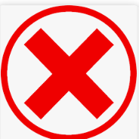
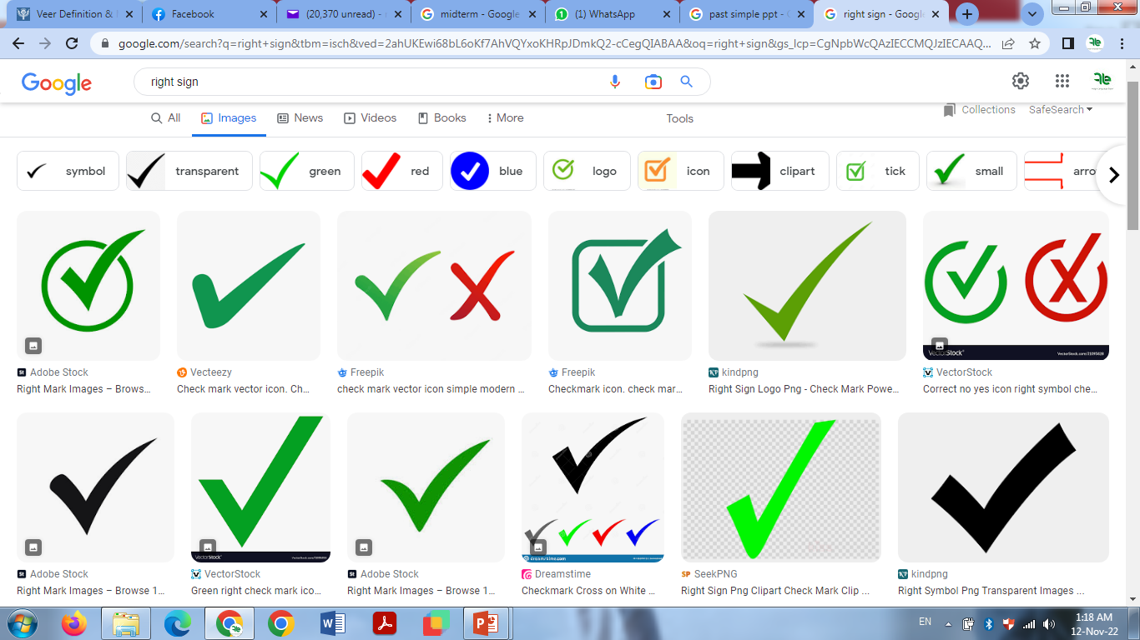
Decide whether these sentences are right or wrong
1-My mother cooks food yesterday .
My mother cooked food yesterday .
2- Ahmed studyed English two days ago.
Ahmed studied English two days ago.
3- The girls went to school last week.

Slide 5
Meaning & Use
We use the Simple Past to talk about an action that started and finished in the past.

Slide 6
Meaning & Use
common time expressions used with the past tense?
last month
In 1980
yesterday
last week
last year
ago

Slide 7
Examples:
I played football yesterday.
Last Friday, she visited her grandmother
These actions
are over, finished!

Slide 8
How do we form the simple past tense . . .?
English has two types of verbs in the past tense:
Regular verbs
Irregular verbs

Slide 9
Regular
…add – ed
Simple Form
climb
I climbed a mountain last year.
watch
I watched the TV an hour ago.

Slide 10
Regular
If the verb ends with e
…add –d
Simple Form Past Tense
Move
I moved to Egypt last year.
Live
I lived in Cairo when I was young.
move
d
live
d

Slide 11
Regular
If the verb ends with e
…add –d
Simple Form Past Tense
Move
I moved to Egypt last year.
Live
I lived in Cairo when I was young.
move
d
live
d

Slide 12
Regular ends with y
i
o
…what comes before y –vowel
u
a
e
ed
Play play
We played football yesterday.

Slide 13
Regular ends with y
…what comes before y –consonant
ied
Simple Form Past Tense
Study
Cry
stud
ied
cr
ied
We studied English yesterday.

Slide 14
For regular verbs, simply use the –ed form of the verb in a positive sentence.
When I was a child, I ___________ the piano. (play)
Donna ______________ Paris. (visit)
played
visited
**Be careful with
spelling changes!

Slide 15
Irregular. .
…DON’T add –ed
Change them
Simple Form Past Tense
become became
give gave
drive drove
forget forgot
Examples

Slide 16
Examples:
Simple Past
teach taught
bring brought
Leave left
Hear heard
Buy bought
Celia bought a new computer last weekend.

Slide 17
And some irregular verbs don’t change at all . . .
examples:
Simple Past
hit hit
put put
set set
The children put the dishes on the table every Sunday.
The children put the dishes on the table last night.

Slide 18
Unfortunately, these forms must be memorized!
Last week, I ___________ you a letter. (send)
The students __________an English exam. (have) They _______ a great job! (do)
sent
had
did

Slide 19
For negative sentences, USE
did not
verb,
base
Form
(Infinitive)
+
or
I went to work yesterday.
I didn’t go to work yesterday.
didn't

Slide 20
Exception = VERB (BE)!
The verb to be is special.
Never use DID NOT or DIDN’T with the verb BE. Instead, just use:
Was
+
not
or
were

Slide 21
For Yes/No questions, USE
verb,
base
Form
(Infinitive)
DiD
subject
+
+
Did you go to work yesterday?
Did you come yesterday?

Slide 22
Put the verbs (between brackets) into the correct form (simple past).
Last year, I (spend) ________my holiday in Ireland. It (be) ________great. I (travel)___________ around the city by car with two friends and we (visit) ________lots of interesting places. In the evenings, we usually (go)_______ to a café.
We (be) ________very lucky with the weather. It (not / rain)___________ a lot. We(see) ________some beautiful rainbows.
I (have) ______ an amazing holiday!
spent
was
travelled
went
were
didn’t rain
saw
had

